Slide 1
Social Media & Web Analytics
Introduction

Slide 2

it’s a BOY!!

Slide 3





My career so far..

Slide 4





Consulting and Research..

Slide 5

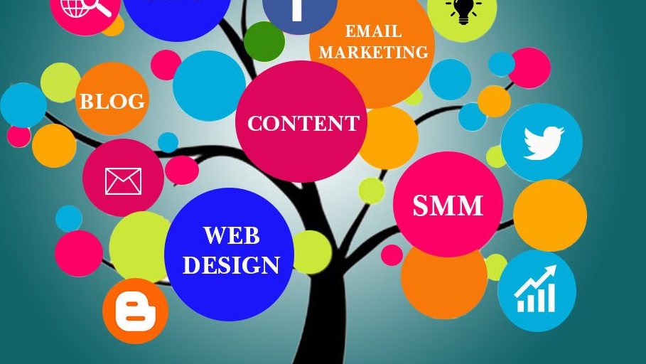
What is this course about!

Slide 6
Things that you really care about
Evaluations:
25% Case study assignments: A 2 page summary of the * case mentioned in the course pack.
75% Group project: Write a paper about any firm or brand in the Indian business space focusing on key digital and social media strategies. Focus should be on applying the frameworks learned in class.
General Type of work:
Combination of case studies, in class activities, R/ excel
Pedagogy Style:
Active

Slide 7

Things that I would love if you care about
Digital marketing

Slide 8
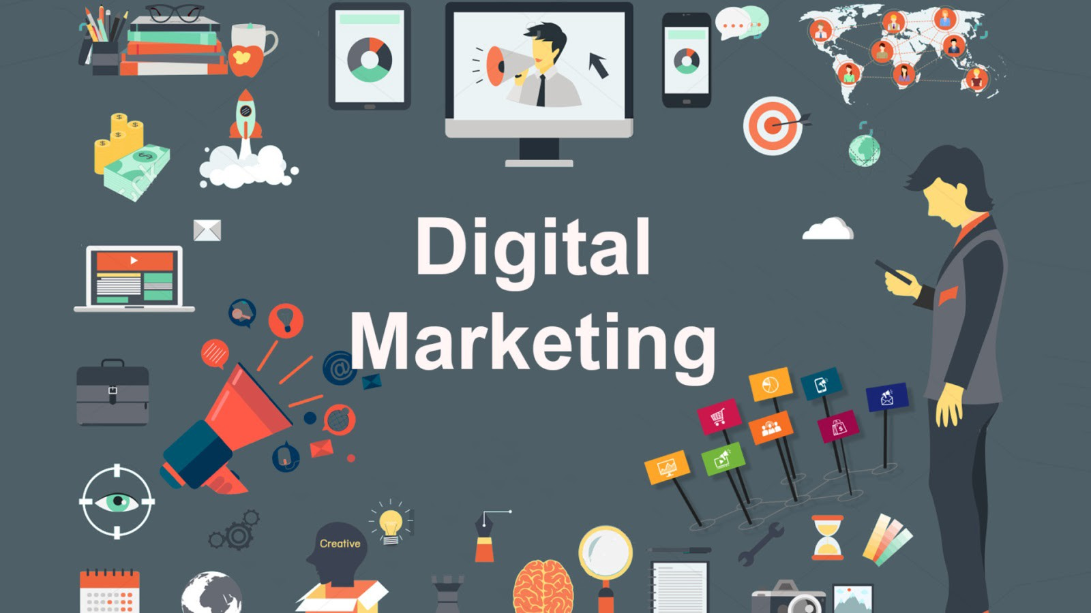

Slide 9
Marketing Strategy & Research
Collaborators
Segmentation
Value for Customer
Equity (Value, Brand, Relationship)
Customer Satisfaction
Customer Value
Acquisition, Retention, Profitability
Firm Value
Sales, Profits
Growth rate
Customers
Consumer behavior
Search Engines
Platforms/ two-sided markets
Contextual Interactions
Social Media & UGC
Company
Product / Service
Price
Promotion
Place
Targeting
Positioning
Context
Competitors
Digital Technologies
Adapted from Kannan and Li. (2017). Digital marketing: A Framework, review and research agenda. IJRM, 34, 22-45
Notes:
Digital technologies affect
Consumer behavior by changing how consumers acquire information (quality and price), the search process and consumer expectations.
UGC, platforms etc. transform consumer-consumer interactions and consumer to seller.
Search engines. Think of digital technologies as colloborators in the digital journey.
Contextual interactions involve geography, privacy and security, regulation and piracy.
Digital technologies and company actions
products are being changed in three fundamental ways – 1) augmenting core product with digital needs, 2) networking of products to release the dormant value, 3) morphing products into digital services
Pricing challenges
Pricing, channels etc. is important
Promotion – new ways to reach and target customers through e-mails, display ads and social media.
Digital on outcomes:
1.

Slide 10
Focus of this class
How digital technologies interact with the 5Cs. In addition, we will focus on a couple of Ps – promotion and place
Area of Focus | Key Topics
Consumer Behavior | Stages of buying process Information acquisition, search, information processing and decision aids in digital environments Customer trust and risk perceptions in digital environments
Social Media and UGC | Electronic Word-of-Mouth (eWOM) and motivation for eWOM, Social networks, identification and targeting of influencers, eWOM and fake reviews
Search Engines | How to choose specific keywords and bid on them Relationship between rank, click-through rate and conversion rates Synergy between organic search and paid search
Contextual interactions | Interaction between geography/location and digital environments Impact of regulatory environment - Privacy concerns and effectiveness of digital marketing
Promotions | Display advertising Retargeting Mobile targeting
Place | Omnichannel Strategy and behavior

Slide 11






Slide 12
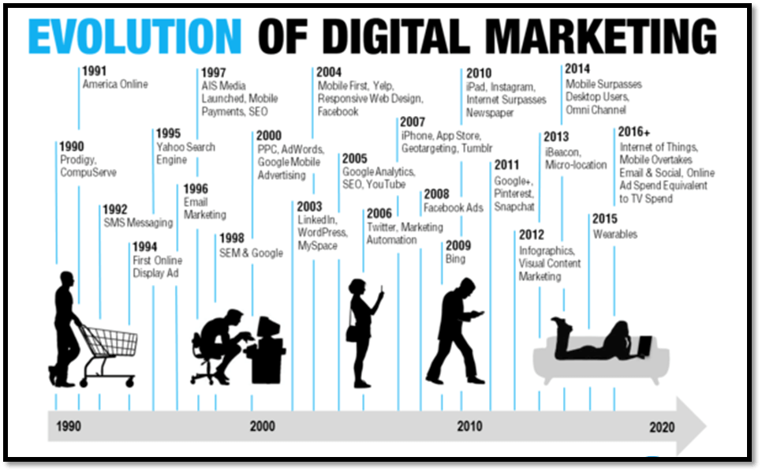


1991
2008
AOL
1998

Slide 13





Psychology of digital marketing
Good marketing strategy begins with an in-depth understanding of how people think about different products and services
Interact consumers effectively and efficiently

Slide 14
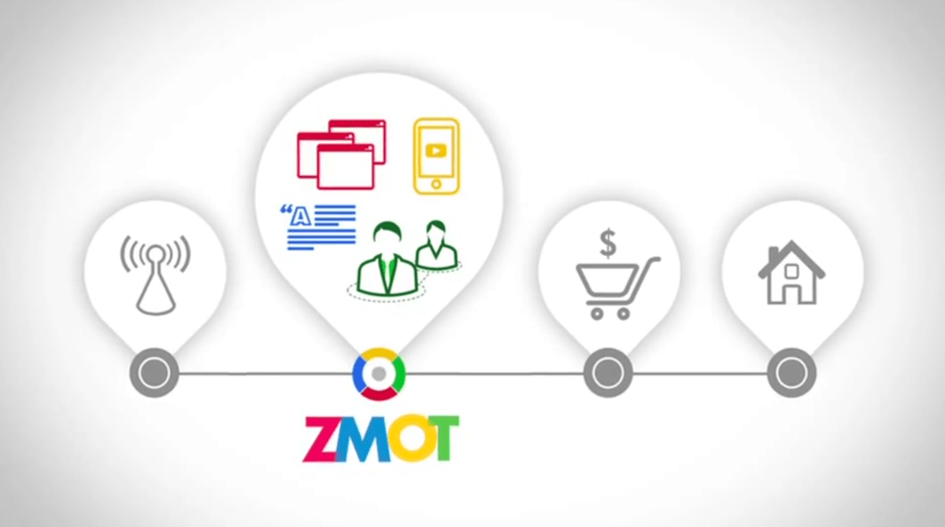
Zero moment of truth model

Slide 15
What to make of the consumer behavior models?
Every shopper is unique
"Why would people make decisions based on the opinions of strangers? They don’t. They make decisions based on the opinions of people like themselves. Which is who they find at ZMOT" Jim Lecinski
Just mass advertising is no longer effective or sufficient
Shoppers are multichannel and multi-use (Attribution Strategies)
Firms can never win. Consumer always do… firms can only enable and help consumer on their journey. Earning their trust and attention is how you develop value
SO WHAT DO MARKETERS DO?

Slide 16
Strategies in the digital world
Collect data about the brand across as many review sites, blogs, forums and social networks as possible (LISTENING)
Compare with your competitor on searches and consideration process. Consumers form consideration sets faster (SEO & Bidding Strategies)
Map your consumer decision journey. Do it across multiple persona types (Mobile, Social Networks, UGC)
Walk in the consumers shoes as much as possible, what is their experience of searching in your market, exploring intermediary or influencer sites, including how does your site and others in the market work in smartphone or tablet devices, and of course on a PC
Build trust, reputation. This is about relationship building, not a sale anymore (Digital Marketing Strategy)
Showing up is 80% of life ~Woody Allen

Slide 17
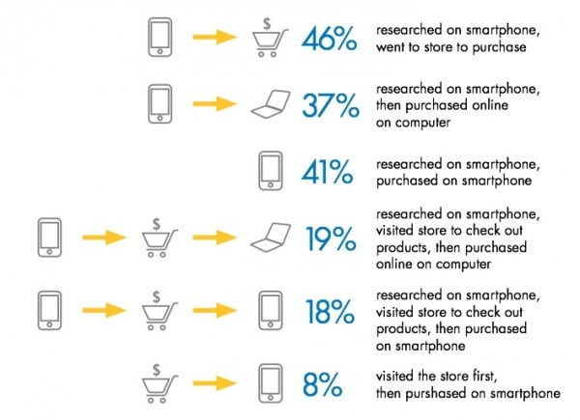
Insights on different CDJs

Slide 18
A ZMOT (inbound) way of looking at the CDJ
Customer advocacy, out of your hands but try to provide the platforms
Search engines, social networks, publishers and blogs
Consider
Evaluate
Buy
Enjoy/Advocate
Measures
Repeat purchase
LTV
Referrals
Measures
#Fans
# Visitors
# Inbound links
Measures
Sales, revenue
Average order value
Measures
#time on site, Bounce rate
# comments, likes
# leads, lead conversions
Retail/e-commerce experience, product, price and promotions
Website, blog, interactive and experiential tools

Slide 19
How do we use Digital and social media strategy
A Purpose driven approach

Slide 20
digital and social media
Talk
(persuade)
Offer arguments
(advertise)
Listen
(marketing research)
Offer deals
(promotions)
Firm-to-consumer
(create and distribute content)
Consumer-consumer
(create content)
Customer – initiated
(Inbound marketing)
Firm – initiated
(Outbound marketing)
Class of Tool:
Social chatter, online buzz
Daily deals, flash sales
eWom, viral, review sites
search engine ads, earned, owned media
Display ads, online video ads
Examples:
Facebook, Twitter
Groupon, Couponduniya
Yelp, TripAdvisor, Amazon.com
Google, Youtube, Facebook Pages
Google Display, websites, Facebook
Adopted from Texiera, 2013: Digital Marketing Strategy, HBR 9-514-087

Slide 21
Summary
Digital world of marketing is changing fast
Consumers are empowered
Understanding the consumer decision journey is primary
Showing up where the consumer is 90% of the battle. That makes it easy to know where to start but impossible to master
This course is not about predictability or identifying the next trends but strategy
use current and past to learn about what to do in the future

Slide 22
Key Learning Outcomes
Digital marketing framework
ZMOT

Slide 23

BREAK – 5 minutes

Slide 24
Search Engine Advertising
Measurement and Effectiveness

Slide 25
Terminology
Algorithm: Program used to rank websites
On-page: SEO factors on website that affect rankings
Off-page: SEO factors offsite that affect rankings (backlinks)
Metadata: code
Robots: crawlers
Keyword Density: number of repeat keywords on a page
Tags: pieces of code attached to parts of page
Hierarchy: Structure of pages
Alt text: text associated with images
Index: Search engine’s list of websites
Backlink: A link pointing to your site from elsewhere
Anchor Text: Text that is visible when clicking

Slide 26
Search Engine Optimization (SEO)
All strategies and process taken to improve the visibility of websites to search through organic (earned media, unpaid) results through search engines such as Google, Bing, Baidu etc.
Why do SEO?
Search is still the dominant way that consumers consider and evaluate products and brand (44% of total internet advertising revenue)

Slide 27
Key factors that affect SEO ranking (google based)
Uniqueness of content (actually penalizes duplicate content)
Weighting of inbound links based on popularity and authority
Relevance
What about images?
Flash images are not scanned.
Quality
How do you measure quality of content?
Google’s way – length, number of shares, low bounce rates (what is bounce) and time spent on a site, typographic errors, slow loading or with broken links.

Slide 28
KEY measures - Organic search
Total volume of inbound organic search traffic
# of inbound links
Bounce rate
Time on site
Higher number of pages per visit
Increase in revenue
Form submissions

Slide 29
SEO - Strategy
Persona Development (segmentation) – Who is the typical customer (for e.g. mothers in urban areas in early thirties)
Create logical segments – based on products and features. Which segment is valuable to you, how do customer persona’s vary? Which should your prioritize?
Utilize owned data – Use most visited landing pages or pages visitors spend most time as indicator of intent, brainstorm based on personas
Utilize third party data sources - Use third party data sources to fact check(Google Ads, SEMrush)
Value check – value calculation; popular keywords or not?, check with friends

Slide 30
Rule of thumb keyword selection strategies
Brad Geddes (2010) keywords can be chosen based on:
explicit keywords: which directly describe the product, e.g. “car cleaning in Mohali”
problems keywords: which describe the conditions the product solves, e.g. “dirty car”
symptoms keywords: which describe the problem, e.g. “cleaning car that went into mud”
product names and part numbers: which are the actual product names and/or part numbers, e.g. “3M car wash”.

Slide 31
Other things to help with SEO
Online optimization
Keyword placement (visible content and source code)
Outgoing links
Validity of website (contact etc.)
Offline optimization
Website history
Inbound links
Some Linking Strategies
Reciprocal links – ask other authors or non-competitive sites to link
Shopping comparison sites
Directories or listings
Participation in communities and other social networks
Baits – content related; controversial, humor, news

Slide 32
SEO Strategies – White Hat vs Black Hat
Black Hat
White Hat
Practice of gaining high search engine listings by nefarious means (targets search engines)
cloaking of the real content
the practice is most common for dubious business practices and adult websites, general practices include link spamming, keyword jamming etc.
For e.g., the source code and content that search engine spider sees might say the website is about advice on buying property in Hyderabad – but the site that downloads for the (human) user is an advert for (often spurious) overseas property investment
Practice of gaining high search engine listings by legitimate means (targets humans)
Websites optimized both on technical and content dimensions
General practices include keyword and keyword optimization, backlinking, link building and content development

